Slide 1
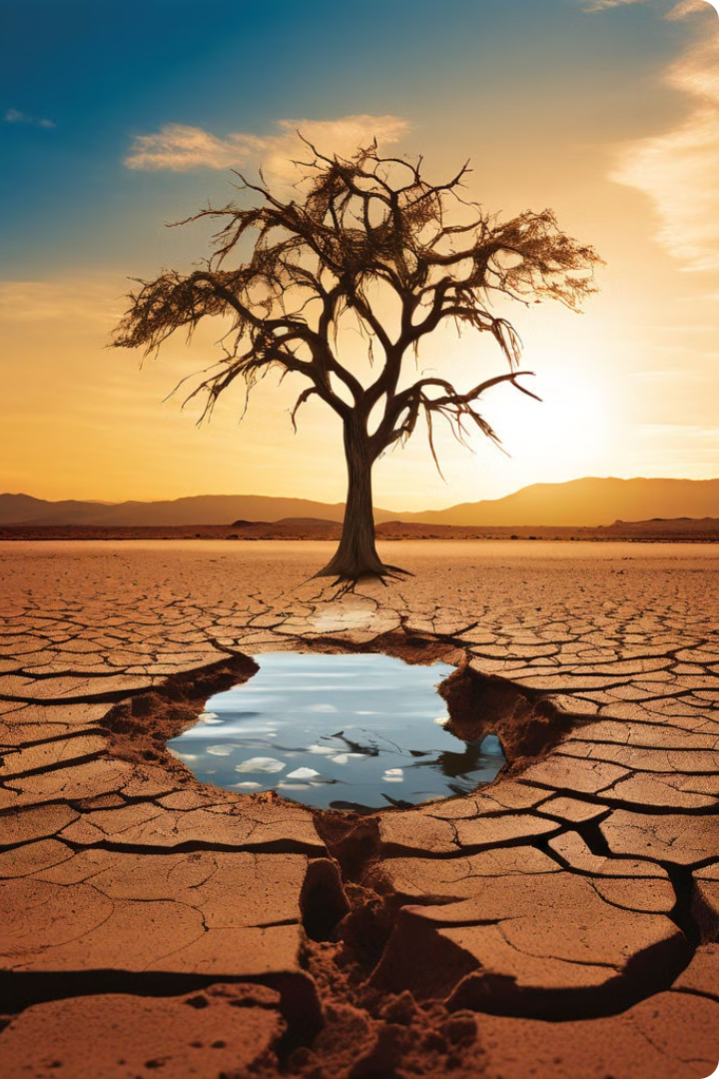
Oasis: Empowering Water Conservation and Sanitation
The Oasis website, integrated with our AI chatbot, harnesses innovative technology to drive sustainable solutions for the global water crisis, empowering individuals and communities to conserve water and improve sanitation practices.

Slide 2


Problem Statement
A chatbot to educate communities about water conservation techniques and best practices for maintaining clean water. The chatbot should answer questions about water-saving methods, provide tips for reducing water usage, and raise awareness about the importance of sanitation.
Water scarcity is a critical global issue, affecting billions and threatening ecosystems. we chose this topic to empower communities with knowledge on water conservation and sanitation, reducing wastage and pollution.

Slide 3

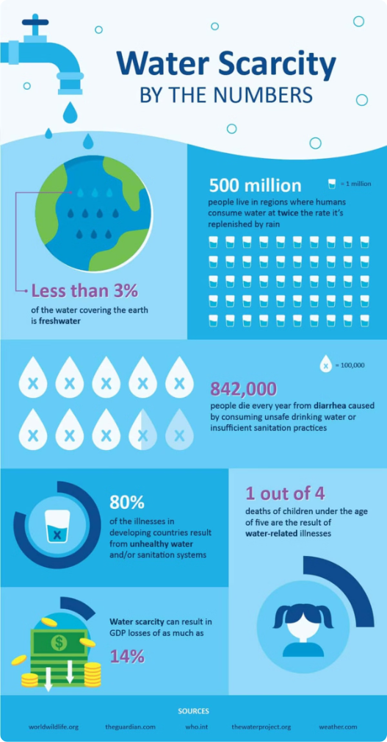
The Global Water Crisis: Challenges and Opportunities
1
Water Scarcity
Millions of people lack access to clean, safe water, especially in developing regions.
2
Pollution and Contamination
Waterways are polluted by industrial waste, agricultural runoff, and poor sanitation practices.
3
Inadequate Infrastructure
Outdated or non-existent water and sanitation systems hinder progress.

Slide 4
Introducing Jarvis: Our AI Chatbot
Purpose
Intelligent Interaction
Accessible Platform
Generational AI
Jarvis is an AI-powered chatbot designed to engage users and provide solutions for water conservation and sanitation.
Leveraging IBM Watson's natural language processing, Jarvis can understand user queries and provide helpful information on water conservation and sanitation.
Integrated into the Oasis website, Jarvis is readily available to users seeking to address water-related challenges.
Jarvis now features advanced generational AI capabilities, allowing it to engage in more natural, human-like conversations to better understand and assist users.

Slide 5

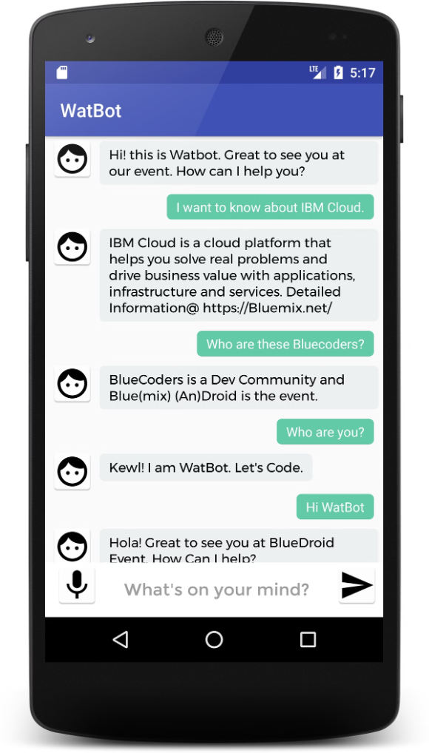
The Tool: IBM Watson Assistant
IBM Watson Assistant is a robust and scalable AI platform that enables Jarvis to understand complex user queries and continuously expand its knowledge and capabilities.
1
Robust NLP
IBM Watson's advanced natural language processing enables Jarvis to understand and respond to complex user queries.
2
Scalable AI
The IBM Watson platform provides the scalability and reliability needed to support Jarvis's growing user base.

Slide 6
Jarvis's Features: Engaging Users, Providing Solutions
Water Conservation Tips
Sanitation Guidance
Educational Resources
Jarvis offers advice on improving sanitation practices to ensure better health and hygiene.
Jarvis directs users to informative articles, videos, and interactive tools on water sustainability and environmental protection.
Jarvis provides recommendations for reducing water usage in the home, garden, and daily activities.

Slide 7

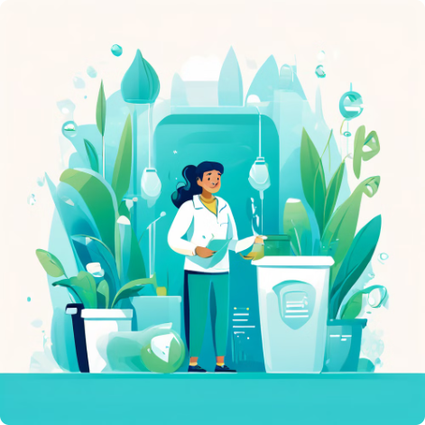
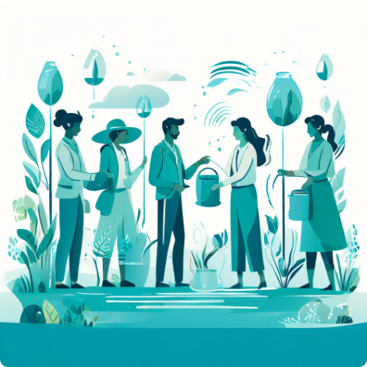
How our model will solve the problem
Water Conservation
Sanitation Solutions
Awareness and Education
Jarvis empowers users to adopt water-saving practices, reducing household consumption.
Jarvis provides guidance on proper hygiene practices to promote better sanitation.
Jarvis helps users understand the water crisis and informs them about sustainable solutions.

Slide 8
Why our model will work
Scalable Approach
Community Engagement
Continued Validation
Our AI-powered solution can reach and engage a wide audience, driving widespread change.
Jarvis encourages users to take action, fostering a sense of personal investment in the water crisis.
While initial results are promising, we are committed to further testing and refinement to ensure sustainable long-term impact.

Slide 9



Technical Innovations: Jarvis's Core Capabilities
Natural Language Processing
User-friendly interface
Cloud Integration
The chatbot is seamlessly integrated into the Oasis platform, leveraging cloud-based infrastructure for scalability and reliability.
Jarvis uses advanced NLP to understand and respond to user queries in a natural, conversational manner.
It boasts a user-friendly interface that simplifies navigation and enhances user experience for a smooth and efficient interaction.

Slide 10

Screenshots

Slide 11
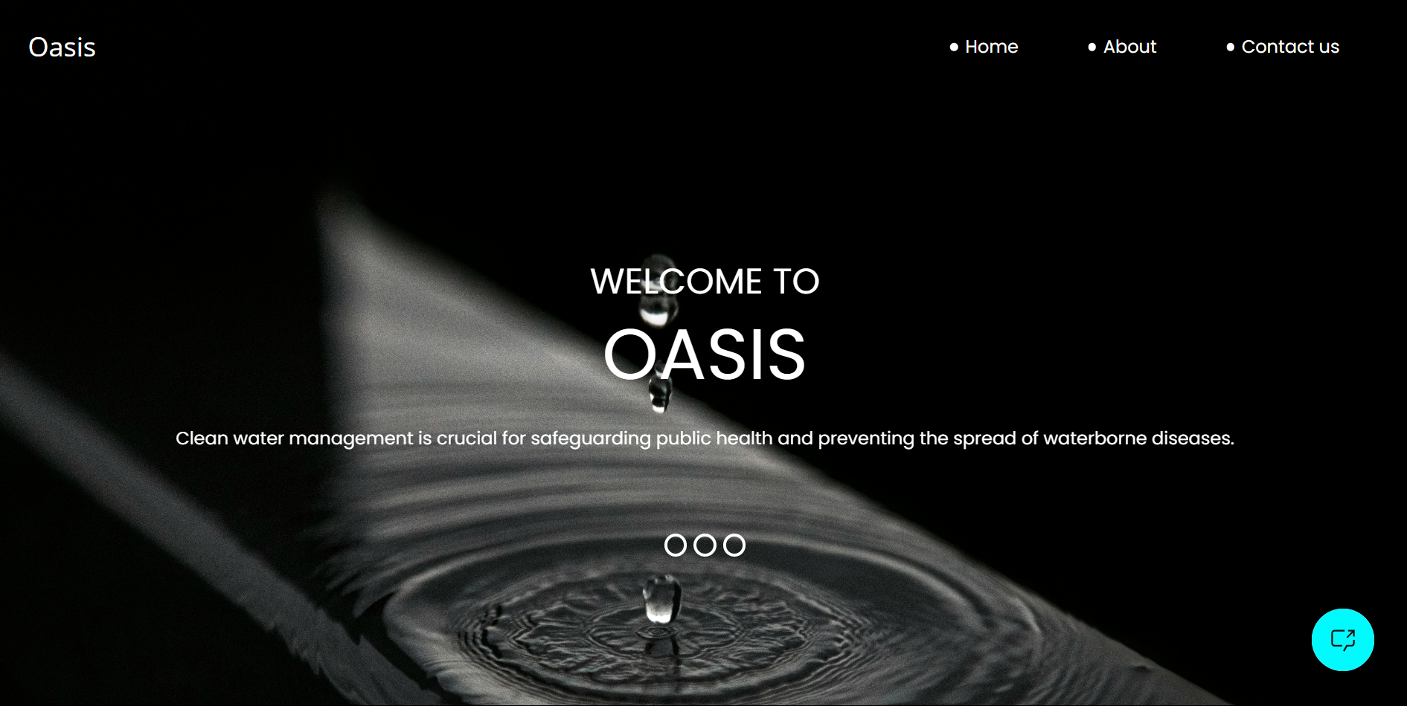

Slide 12
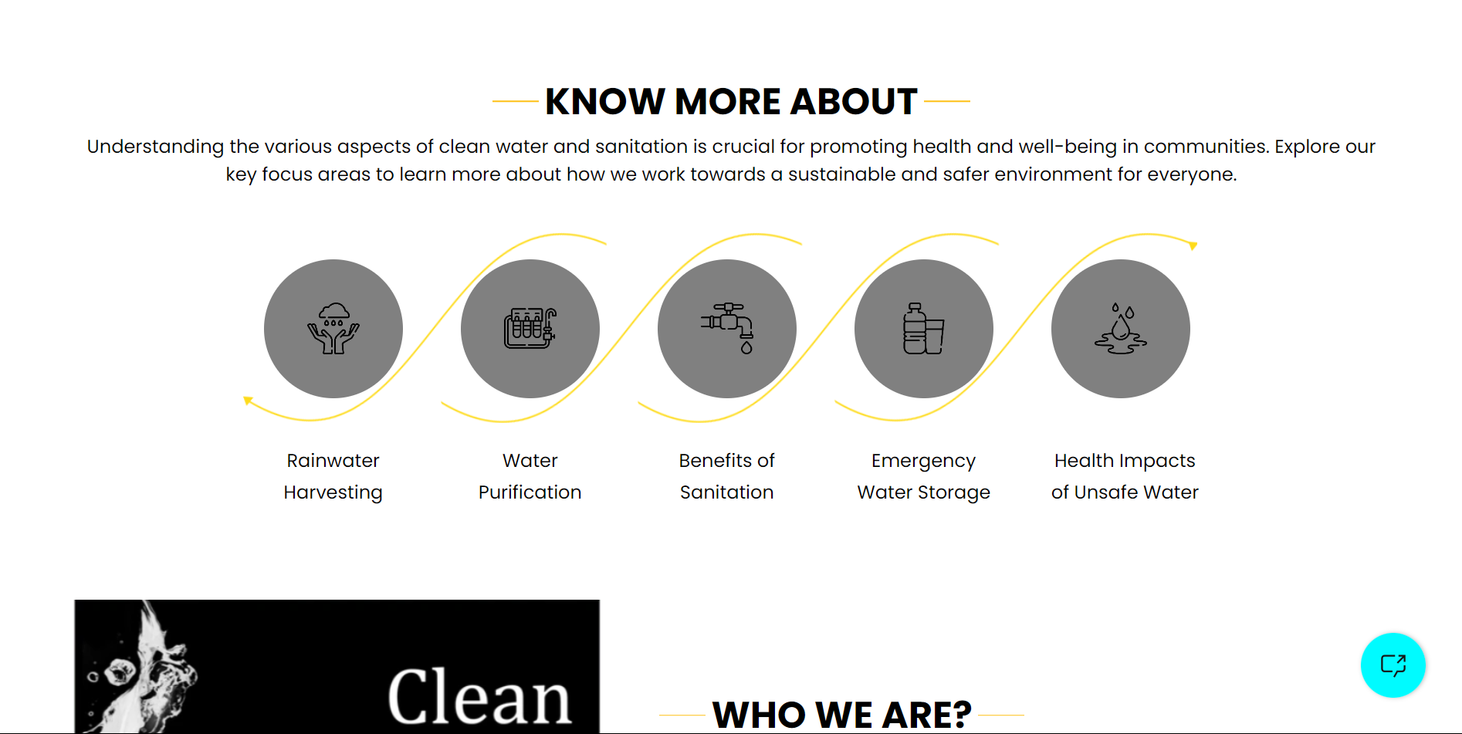

Slide 13
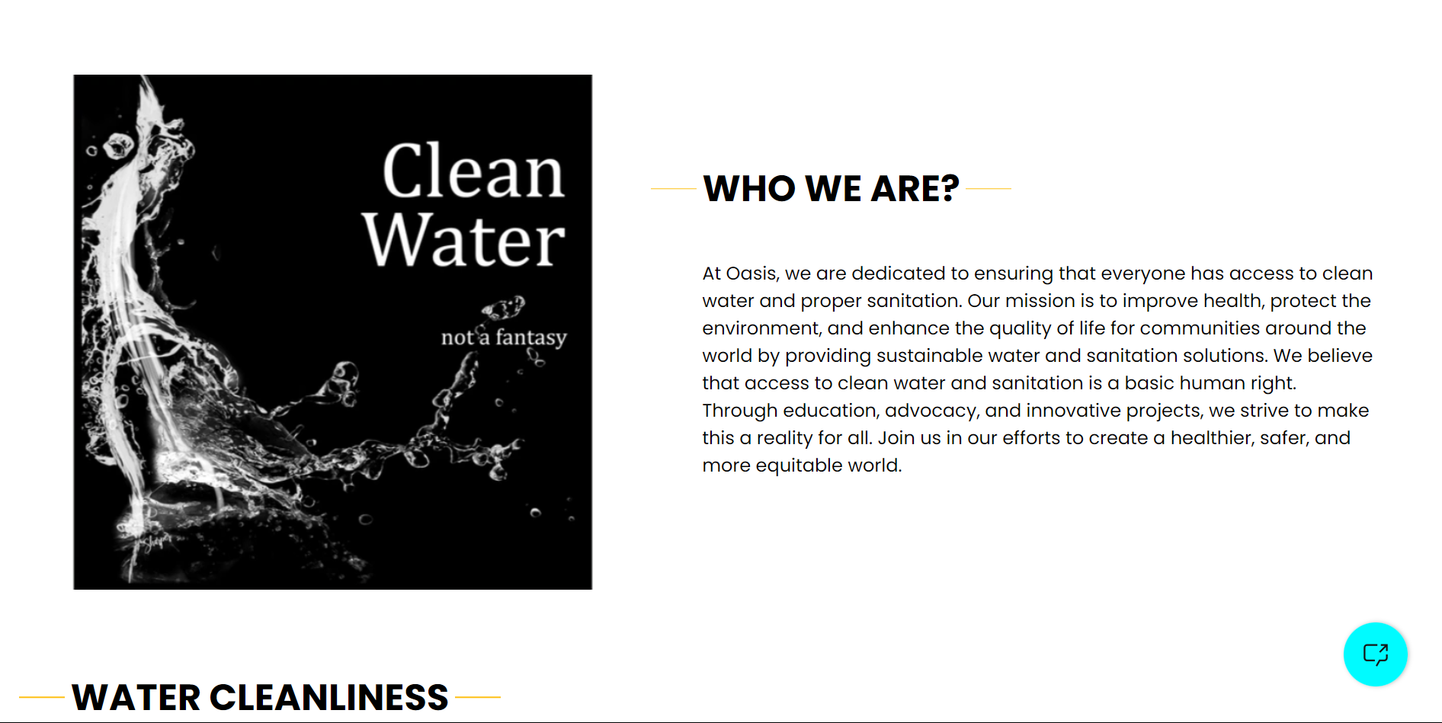

Slide 14
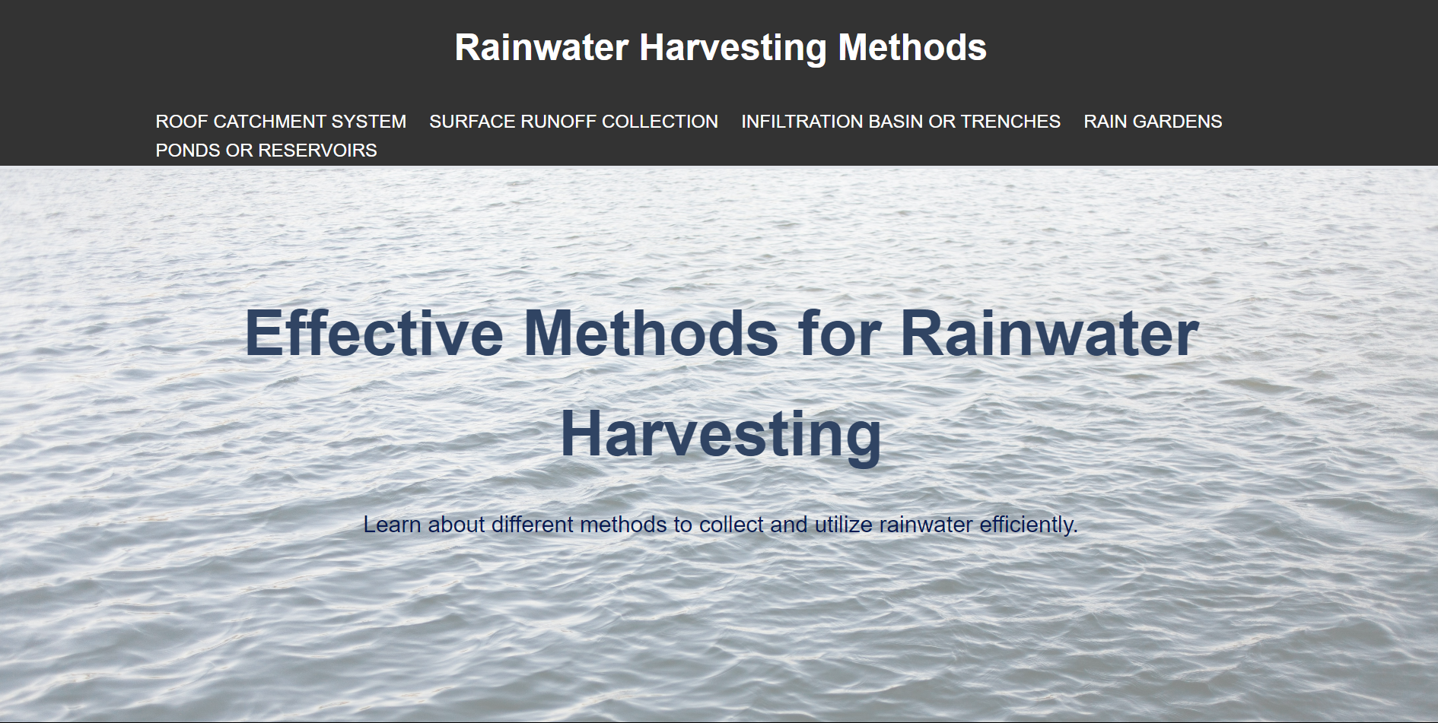

Slide 15
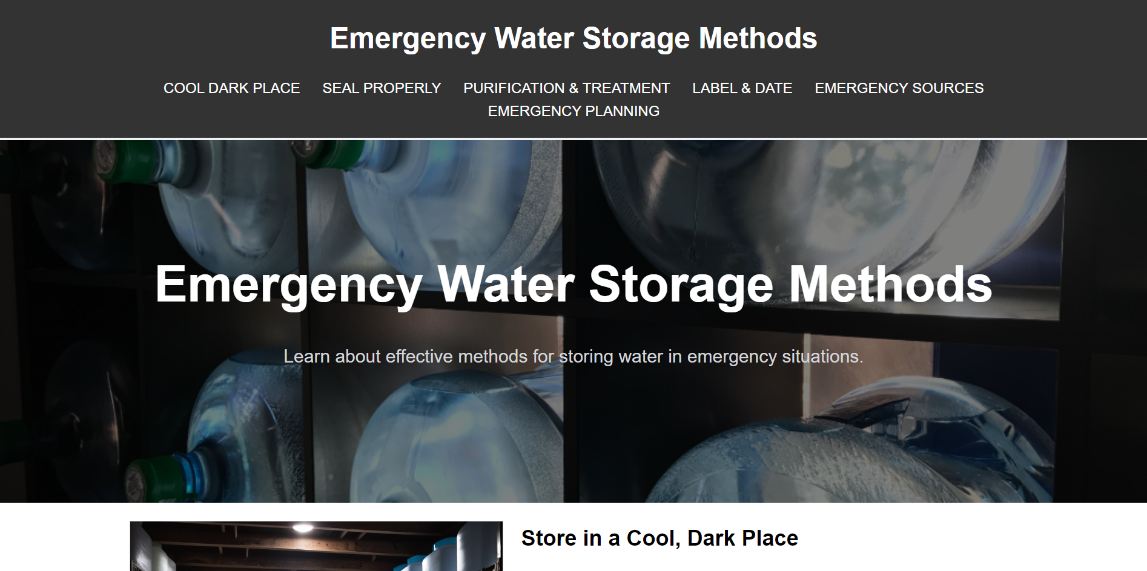

Slide 16
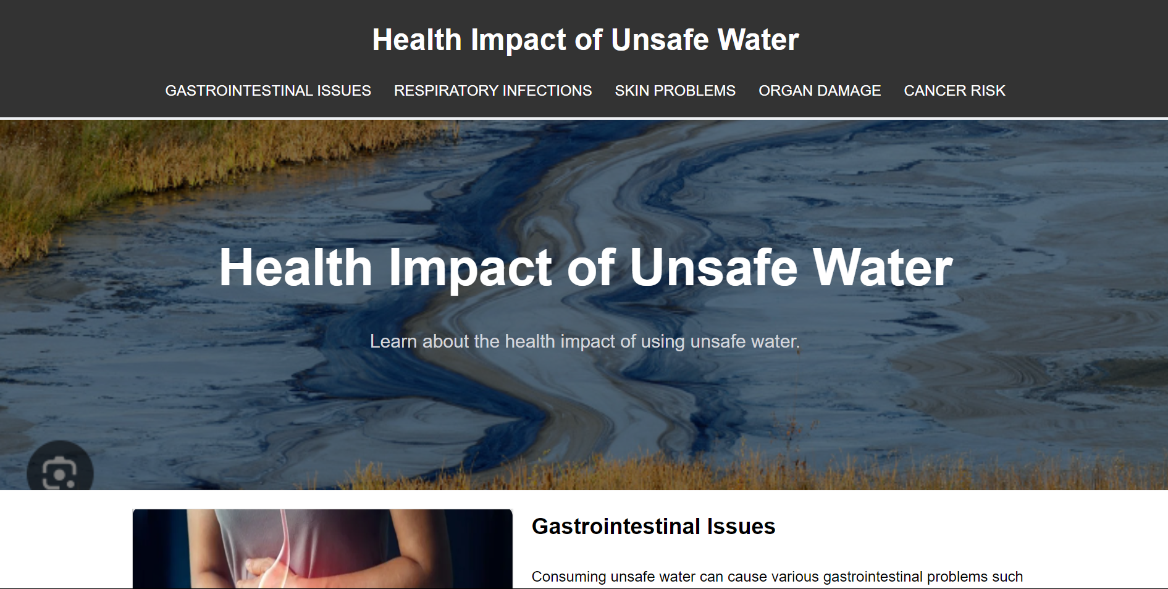

Slide 17
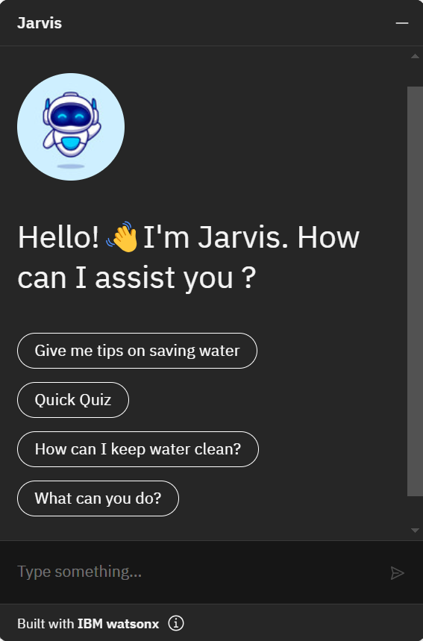
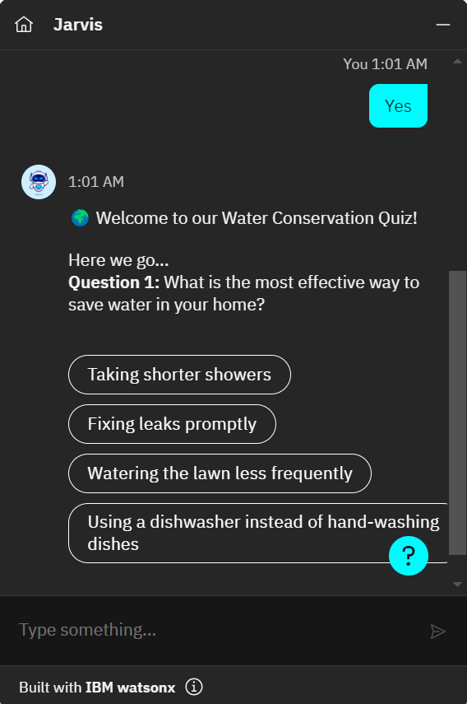

Slide 18
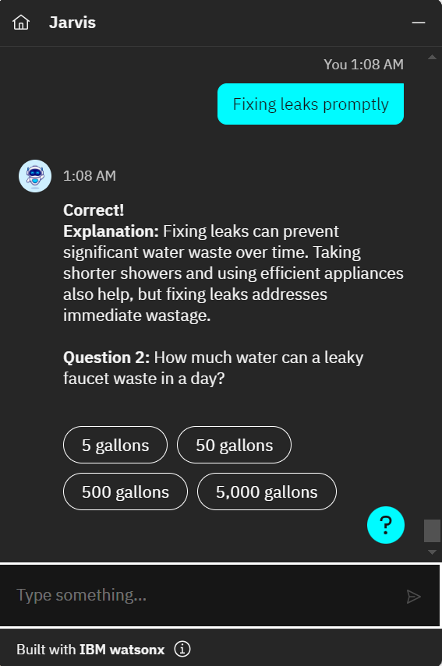
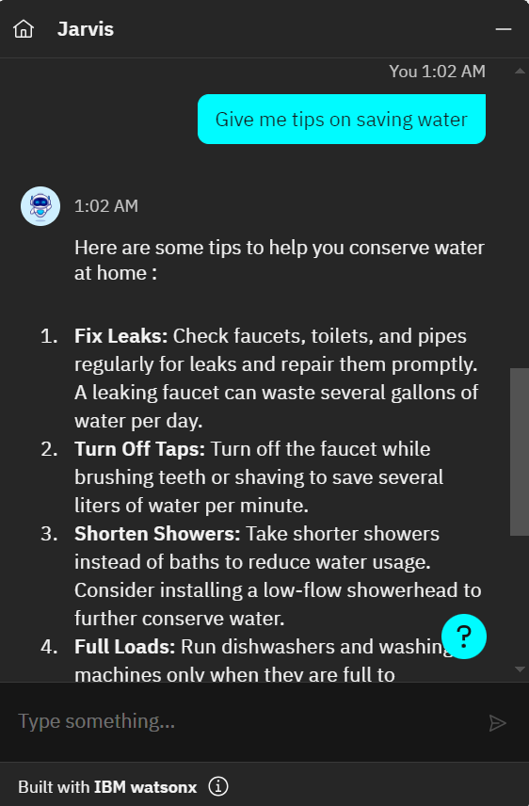

Slide 19
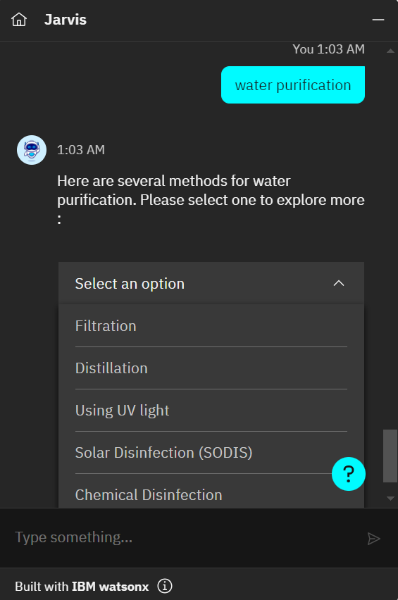
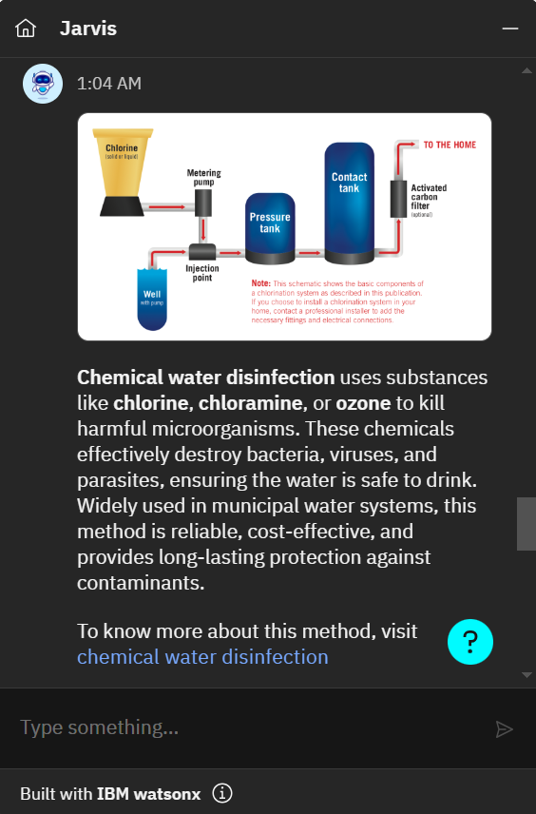

Slide 20

The Future of Water Conservation: Jarvis and Beyond
1
Expanding Capabilities
Jarvis's knowledge and functionality will be continuously expanded to address emerging water-related challenges.
2
Integrating New Technologies
Jarvis will integrate with cutting-edge water conservation technologies, such as smart home devices and IoT sensors.
Empowering Global Impact
3
Jarvis will be deployed across multiple platforms and languages to reach and empower communities worldwide.

Slide 21
Relevant links
Chatbot
Website public url
Link
Link

